Slide 1
Health provision to prepare and support Children & Young People through their Educational Years
Louise Gettings (DCO) for SEND)
Marie Baron (Commissioning and Transformation Manager – CYP Mental Health & Learning Disability )

Slide 2
To provide a brief exploration of the health offer along a child/young person's educational journey
Demonstrate how this offer links to the Excellence in Education Strategy and SEND Transformation Plan
Expand knowledge and understanding of how we can work in partnership
dvdvd

Slide 3
What are our areas of growth?
EHCP demand by primary need
SEND Type | Jan 2019 | Jan 2020 | Jan 2021 | Jan 2022 | Change 2019-2022
Autistic Spectrum Disorder | 444 | 512 | 560 | 629 | 185 | 42%
Hearing Impairment | 32 | 33 | 35 | 35 | 3 | 9%
Medical Needs | 20 | 21 | 23 | 27 | 7 | 35%
Moderate Learning Difficulty | 206 | 203 | 230 | 277 | 71 | 34%
Multi-Sensory Impairment | 4 | 4 | 4 | 7 | 3 | 75%
Other Difficulty/Disability | 1 | 1 | 1 | 6 | 5 | 500%
Physical Disability | 83 | 66 | 70 | 73 | -10 | -12%
Profound and Multi Learning Diff | 39 | 35 | 34 | 32 | -7 | -18%
Severe Learning Difficulty | 260 | 284 | 287 | 301 | 41 | 16%
Social, Emotional, Mental Health | 475 | 515 | 574 | 603 | 128 | 27%
Speech, Language and Comm Needs | 185 | 202 | 237 | 285 | 100 | 54%
Specific Learning Difficulty | 32 | 32 | 32 | 30 | -2 | -6%
Vision Impairment | 23 | 22 | 24 | 23 | 0 | 0%

Slide 4
SEN Support Demand by Primary Need
SEND Type | Jan 2019 | Jan 2020 | Jan 2021 | Jan 2022 | Change 2019-2022
Autistic Spectrum Disorder | 206 | 254 | 284 |  | 78 | 38%
Hearing Impairment | 124 | 160 | 152 |  | 28 | 23%
Medical Needs | 2129 | 2064 | 1949 |  | -180 | -8%
Moderate Learning Difficulty | 16 | 19 | 20 |  | 4 | 25%
Multi-Sensory Impairment | 227 | 193 | 256 |  | 29 | 13%
Other Difficulty/Disability | 324 | 349 | 317 |  | -7 | -2%
Physical Disability | 115 | 128 | 140 |  | 25 | 22%
Profound and Multi Learning Diff | 6 | 14 | 11 |  | 5 | 83%
Severe Learning Difficulty | 1209 | 1428 | 1408 |  | 199 | 16%
Social, Emotional, Mental Health | 1162 | 1231 | 1344 |  | 182 | 16%
Speech, Language and Comm Needs | 19 | 22 | 32 |  | 13 | 68%
Specific Learning Difficulty | 703 | 668 | 600 |  | -103 | -15%
Vision Impairment | 49 | 57 | 58 |  | 9 | 18%

Slide 5
EHCP Growth 1/1/20 – 10/2/22
 | 2020 | 2021 | 2022 | Grand Total
Autistic Spectrum Disorder | 68 | 85 | 9 | 162
Hearing Impairment | 4 | 1 | 1 | 6
Medical Needs | 3 | 6 |  | 9
Moderate Learning Difficulty | 40 | 57 | 15 | 112
Multi-Sensory Impairment |  | 2 | 2 | 4
Other Difficulty/Disability |  | 3 | 2 | 5
Physical Disability | 7 | 10 | 1 | 18
Profound and Multi Learn Diff |  | 2 |  | 2
Severe Learning Difficulty | 16 | 28 | 1 | 45
Soc, Em and Ment Health | 111 | 104 | 16 | 231
Speech,Lang or Comm Diff | 37 | 48 | 14 | 99
Spfc Learning Difficulty | 3 | 2 |  | 5
Vision Impairment | 2 | 1 |  | 3

Slide 6
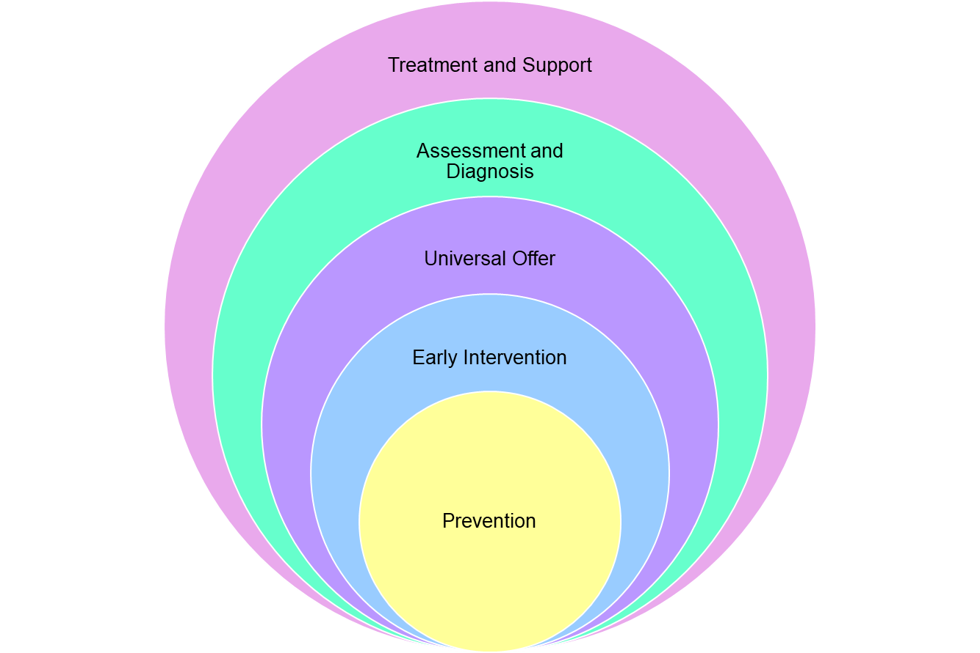
How Health support the Graduated Approach
Paediatricians, SALT, OT, Physio, CAMHS, Audiology, Opthamology, Continuing Care, Complex Nursing Team, Learning Disability Team, Dieticians, Psychologist, Psychiatrists, Eating Disorder Team, Children in Care, Youth Offending, Care Leavers, Specialist Consultants, Acute services, Drug and Alcohol.
Paediatricians, SALT, OT, Physio, CAMHS, Psychologist, Neuro-Disability Team – ADHD/ASD, Opthamology, Audiology, LD Team
Maternity, 0-19 team, Primary Care, Newborn Hearing Screening, Newborn Blood Spot Screening, Safeguarding, Early notification process
Maternity,0-19 team, Primary Care, SALT, dieticians, OT, Physio, Audiology, Ophthalmology, Mental Health Support Team, School Link Team
Maternity, 0-19 team (Health visiting/School Health), Public Health, Safeguarding

Slide 7
What’s working well?
Early Years
Main focus of support in early years settings and primary reception classes for EY
ND Pathway manager is part of the Autism for Schools training offer.
Developing more support for EY education settings to provide good universal and targeted support with joint work on the Graduated Response for children's development and health needs.
Early Years settings offered health training in relation to common health difficulties and how to support.
Provide support/resources/programmes/coaching on individual child basis
Pre-referral Consultation process for Early Years settings and Reception classes and support/ signposting.
Close partnership working with ELCC Team to offer multiagency approach and join planning to support holistic needs.
0-19 Offer
School drop in by School health– staff can attend in relation to an individual concern/query re: CYP. CYP themselves can drop in.
Clinic in a box – sexual health service, offered form school health for yr 9 and above on a y Universal offer- immunisations offer, public health programmes, option for new starters in yr 7 for school health introduction.
0-19 own website and link can be included on the school website, also linked to local offer.
School health profile undertaken which is a whole school approach, team can then elicit need and tailor support accordingly.
Health promotion delivery.
SEND champions in team in HV/School health
Solihull training.

Slide 8
What’s working well?
Speech, Language and Communication – SALT:
Biggest focus on primary schools and early years settings.
High schools- more individually tailored support to specific needs of individual young people
Developing more support for education settings to provide good universal and targeted support with joint work on the Graduated Response for Communication and Interaction with TESS and EP.
Provide support/resources/programmes/coaching on individual child basis
Pre-referral Consultation process for Early Years settings and Reception classes and support with the WellComm roll out in Early Years.
Communication Champion Network – schools sign up and have 1 or 2 comm champions (SENCO /TA) Virtual sessions each term around different aspects of speech. Language and communication
Training packages can be offered to schools where required and capacity allows.
Autism Spectrum Disorder
Neurodiversity pathway
Autism in Schools project
Multi- agency approach to decision making with regular panel meetings.
All assessment tools are used in section 5 of the NICE guidelines.
Consideration is made for additional assessments to be used for each individual child / Young Person.
Partnership working across Education, Social Care and Health.
Clear communication methods are used to discuss outcome of panel.
Parents have an opportunity for their child to stay under review if there is uncertainty or disagreement.
We have just had the information leaflet and flow chart passed for parents so we can share information on the expectations of the ASC pathway, when and what to expect.
Packs of information are shared with parents for support after the decision.
Post diagnostic support, Drop in sessions, and full training programme offered.
Consideration is made to be in line with the NICE guidance, Autism Strategy, and GM standards.
Within 3 months from date of referral we start the diagnostic assessment
Waiting times are shorter in Wigan than in some other authorities.

Slide 9

What are the challenges?
We DO listen to the voice of our children, young people and their families. Our Challenge- more meaningful co-production
Embed the Early Years Wellbeing approach in all Early Years settings. Challenge –capacity/ post pandemic impact om services
Have an effective and responsive early intervention offer for children and young people’s mental health and wellbeing in our education settings. Challenge- increased demand for support.
Improve the education and health offers for young people in or coming out of the criminal justice system.
Develop our work on transition
To provide an effective health offer in all educational settings Challenge- capacity
Improving our identification of SEND and access for those with SEND to universal health offer. We DO comply with early notification process -Challenge ensuring all services do this
We DO support meaningful outcomes for CYP. Challenge –evidence this with robust data
We DO support early intervention offer for young people’s mental health
Support early identification of neurodevelopmental conditions, we have listened and are revisiting our pathways Challenge – mobilisation

Slide 10
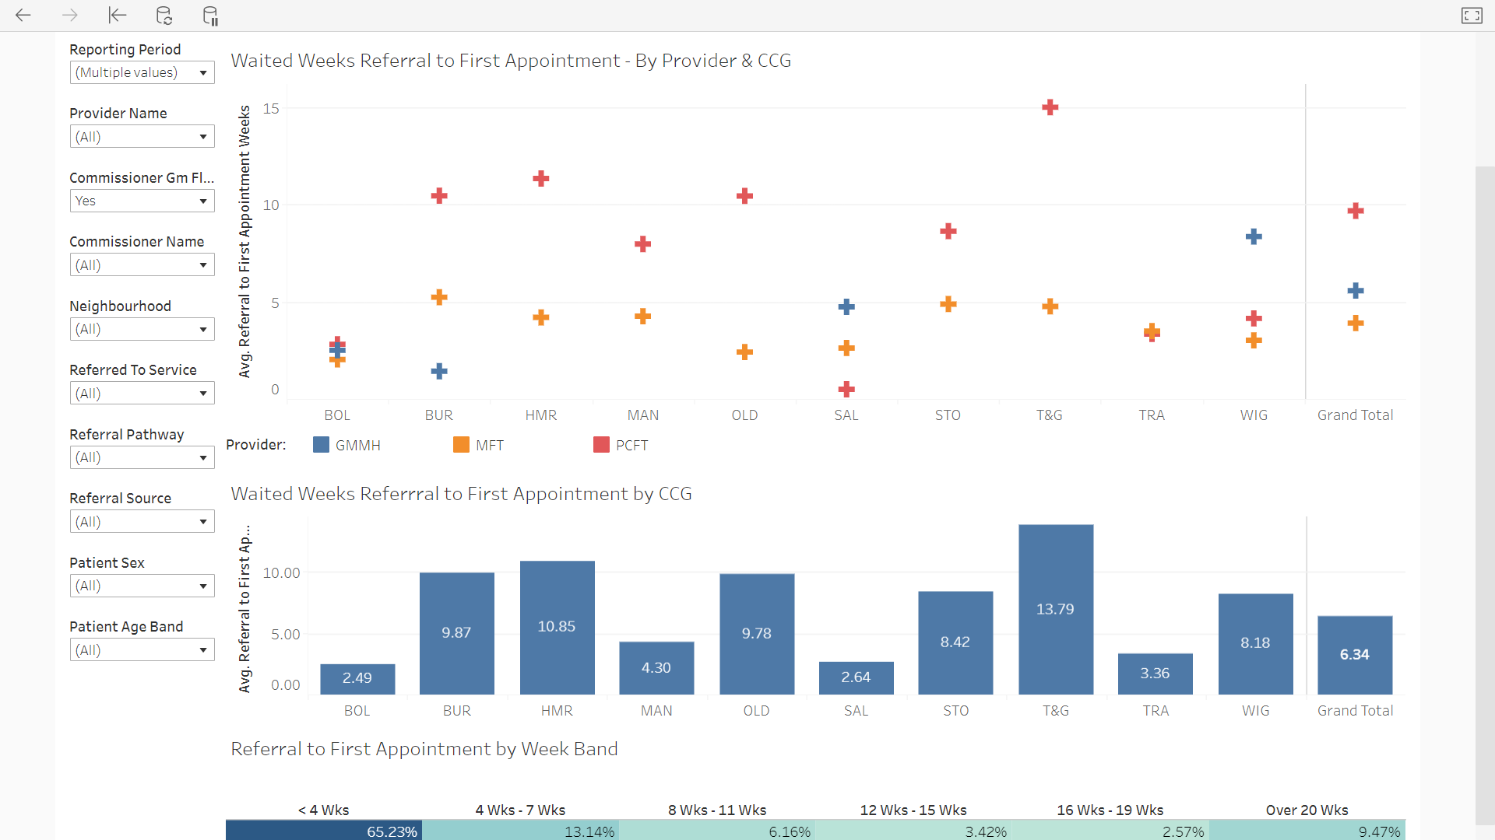
What’s working well?
Social Emotional and Mental Health - CAMHS
Successful transfer of services from Northwest Boroughs NHS to Greater Manchester Mental Health NHS FT (April 2021)
Improved waiting times to access treatments (currently 8 weeks between September 21 & February 22)
Multiagency working to support CAMHS front door – partnership includes Family Welfare, MHST, School Link Teams, Wigan Youth Zone and StartWell.
Providing support/resources/programmes/coaching on individual child basis to system partners including Social care for Looked after Children
Frequent engagement with young people accessing services.

Slide 11

What are the challenges?
Demand outweighing capacity – increase of referrals by 15% just this month.
Impact of Covid-19 on children and young people’s emotional health and wellbeing.
Impact of Covid – 19 on staff – a workforce that has not been immune to the impact of Covid with sickness and burnout.
Increased complexities in young people’s mental health.
National shortage of workforce.
Alternative provisions for lower level emotional health and support. i.e. counselling.

Slide 12

What’s working well?
Social Emotional and Mental Health – School Link Teams
Have good and well established relationships with schools in the Wigan Borough
Only have 1 vacancy awaiting recruitment. Just waiting on start date for some of the practitioners.
Positive feedback received from schools engaging in the offer.
Offer remained consistent throughout Covid and the team have adapted areas of the offer to ensure continuity throughout the pandemic.
Improved the referral process to make referrals more effective and efficient.

Slide 13

What are the challenges?
Recruiting into the team during the pandemic
Retention of staff due to development opportunities
Increased number of referrals from September 2021

Slide 14
What’s working well?
Social Emotional and Mental Health – Mental Health Support Teams (MHST)
MHST teams fully recruited too.
Launch of Mental Health Support Teams in 28 Schools
Whole School Audit undertaken with staff to understand how well they feel they manage emotional health and wellbeing of students
Surveys have been sent out to the families of young people in MHST schools to help shape future development of teams.
Co-design of the MHST team branding with young people.
Referrals have begun to sent to team.

Slide 15
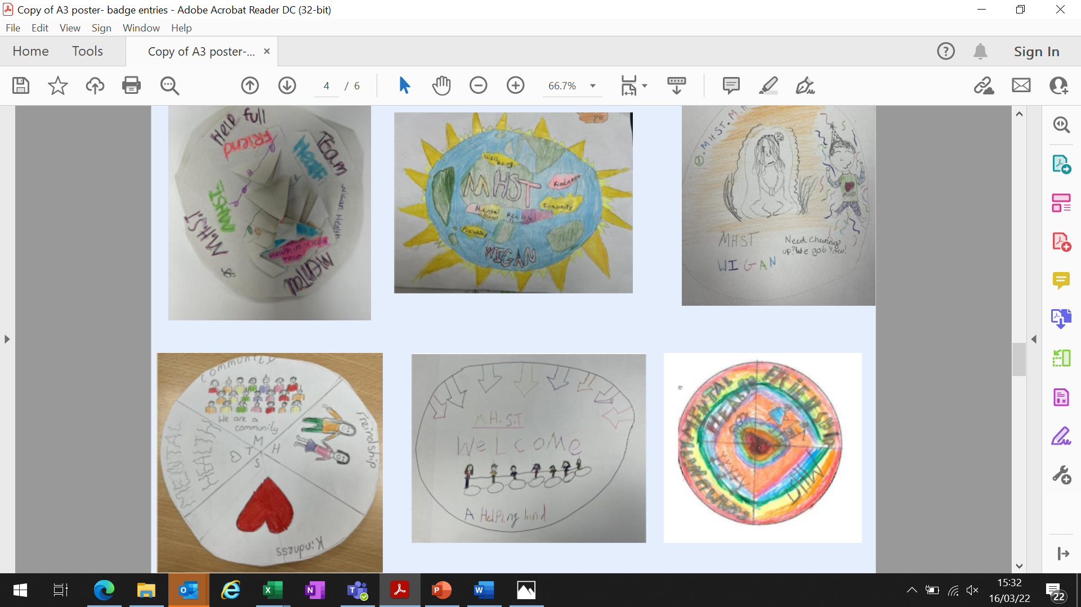
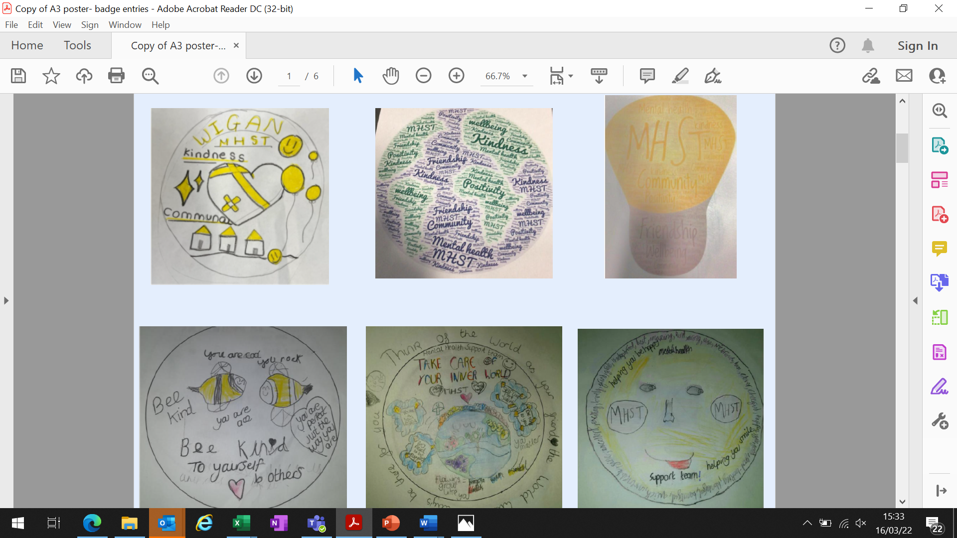
What are the challenges?
Retention will be a challenge
School participation
Managing case load whilst EMHP in training
Managing and escalating inappropriate referrals or risk referrals
Picking a winner of the MHST Badge competition.

Slide 16


Slide 17


Slide 18


Slide 19

Next steps and vision?...........
How can we progress and grow our partnership locally?
Continue working in partnership with all services & engaging with Youth groups.
Get to know each other more
Work with us in health DCO/ Commissioners,
Be influencers together
Grow together
Be stronger together!

